Slide 1
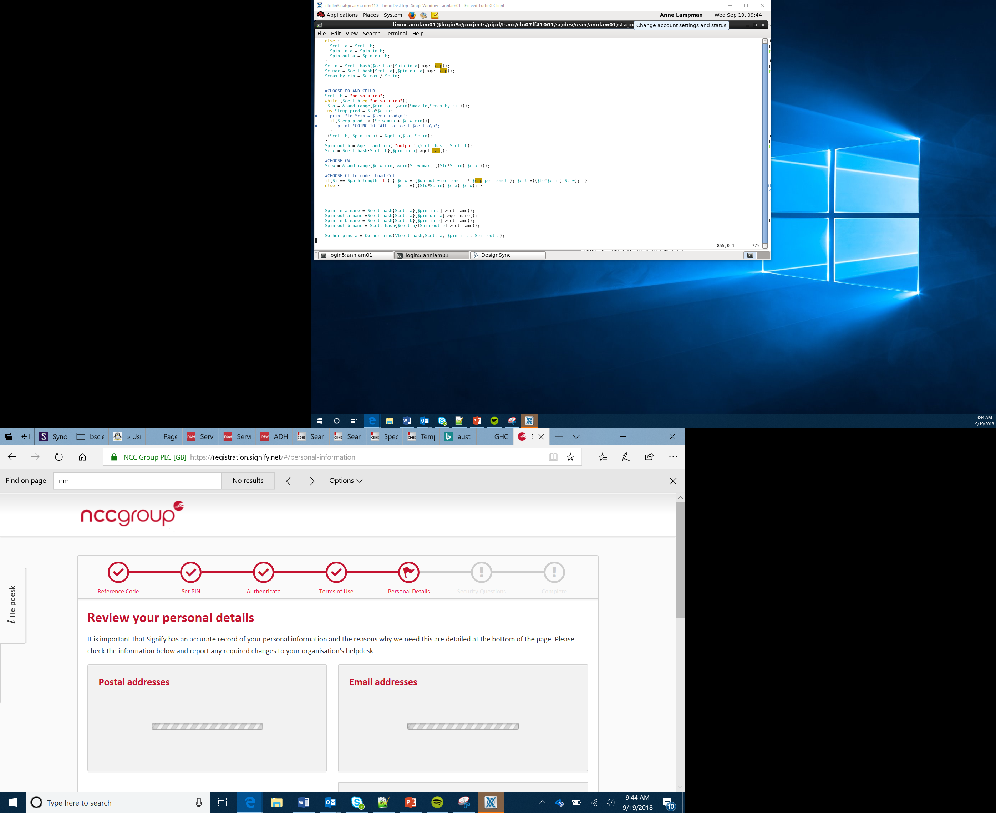

Variables, Selection and Incrementing a Stored Value
Lesson 4

Slide 2
What the Lesson Will Cover
Know what a variable is
Create a variable
Use selection, buttons and variables to keep a running total, similar to that used in a game
Be aware of the pins and some of their uses
Wire up a circuit using the pins and program a response
Apply understanding to build a simple alarm system
Notes:
This lesson starts with a recap of the theory of variables, selection and using them with button interactions.
Learners should complete the activity sheet as the main focus of the lesson as this prepares them for the first Project, A Healthy Eating Quiz”
Discuss that the micro:bit has a number of pins. Can the Learners locate them? Talk over some of the pins and what they do, the GND pin, power pins, input and output pins.

Slide 3
What is a variable?
A variable is a location in the computers memory, usually the RAM, where data is stored.
This data can be text, characters, numbers or values.
First a variable is declared by naming it followed by the = sign.
For example name = ‘Arm Education’
What is the variable called?
What is stored in the variable?
What type of data is stored?
Notes:
The variable is name
It stores Arm Education and it is a string

Slide 4

Variables Are Like Storage Boxes
Arm Education
$50
74.6
name
income
How many variables are shown on this slide?
Create a variable
Use selection, buttons and variables to keep a running total, similar to that used in a game

Slide 5
Variables Can Be Updated and Overwritten
x = 4
x = "Len"
print(x)
?
x
Look at the program
What is stored in the variable at the start?
What is stored in the variable at the start?
Notes:
Learners start the activity a create program using variables, selections and inputs

Slide 6
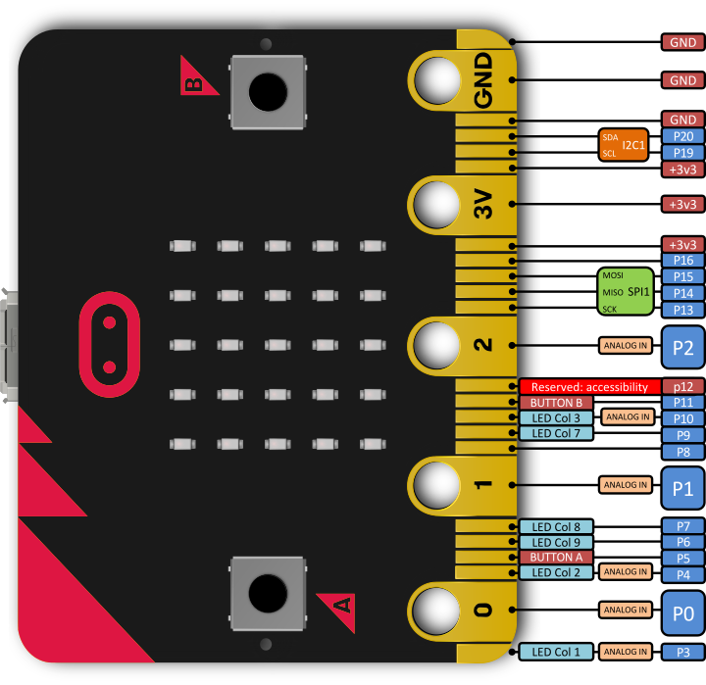
Pins
The pins enable you to add additional input, outputs and control to your micro:bit and programs
For example:
Attach a temperature sensor and write a program to respond to the readings
Attach a motor and power it via the 3V pin
Notes:
Discuss that the micro:bit has a number of pins. Can the Learners locate them? Talk over some of the pins and what they do, the GND pin, power pins, input and output pins.

Slide 7
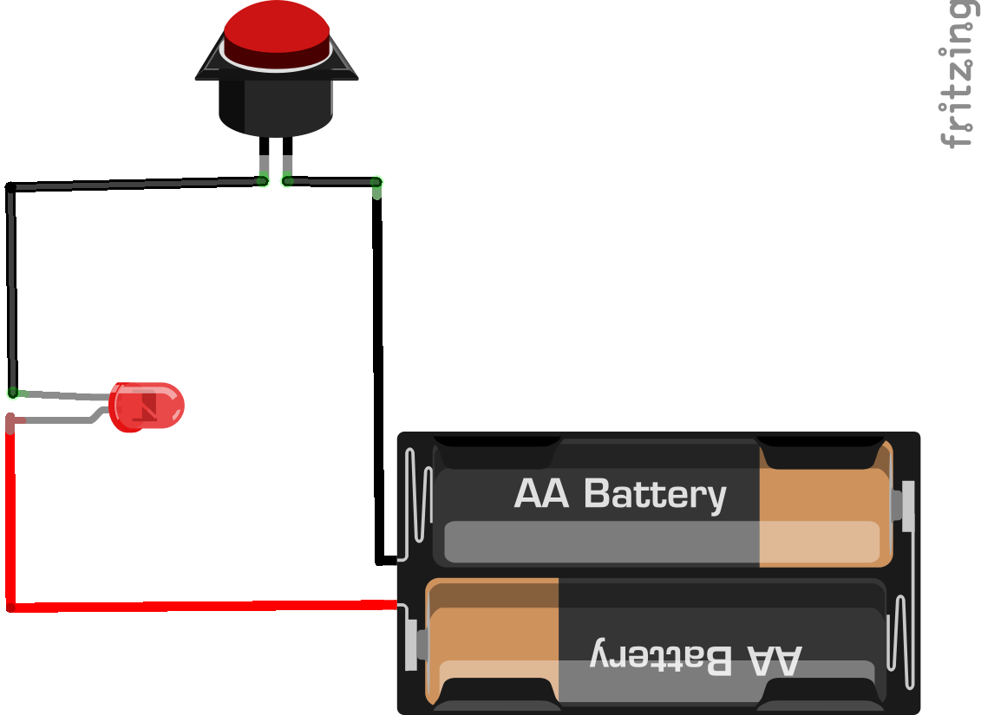
How Pins Work
Switches can be used to open and close circuits
When the button is pressed the circuit is closed and the current can flow from the battery and power the light
Pins work like switches and buttons – when you join them together, usually with a wire, it closes the circuit and an event is triggered

Slide 8
Pins
The 5 main ring pins do the following:
Pin 0 – input
Pin 1 – input
Pin 2 – input
Pin 3 – provides a voltage of 3V
GND – grounds the pin to make the circuit
By using crocodile clips and joining Pin 0 and the GND it creates a circuit. Code can then be used to respond
Notes:
Discuss that the micro:bit has a number of pins, can the Learners locate them? Talk over some of the pins and what they do, the GND pin, power pins, input and output pins.

Slide 9
25 Additional Pins
The micro:bit also has 25 smaller pins
These pins range from providing
3V supply
Controlling the LEDs
Controlling the A and B buttons
Adding a crocodile clip to Pin 5 and joining it to the GND pin is the equivalent to touching Button A
Notes:
Discuss that the micro:bit has a number of pins. Can the students locate them? Talk over some of the pins and what they do, the GND pin, power pins, input and output pins.

Slide 10
Student Activity
Complete the first part of the Activity Sheet and create your own response to touching the pins
Notice that we use a while True loop to keep the program running
What would happen if we removed the loop?

